Slide 1



Sales Project
by - Yash paropkari
www.linkedin.com/in/yash-paropkari-6351b62b8
https://github.com/Yashparopkari/Resume-sales-project

Slide 2

Title and Content Layout with List
Sales Project of XYZ company
Product Description
Dashboard
Suggestions
What did I learn from this Project ?

Slide 3

Project Description
The company is product based .Here we are using Sample dataset.
This Dataset is found with google on git hub
The company is unknown
As per the information the sales of the company is declining
As analyst we have to make attractive dashboards and meaningful insights
So that the company can take decision and with resulting sales increases.

Slide 4
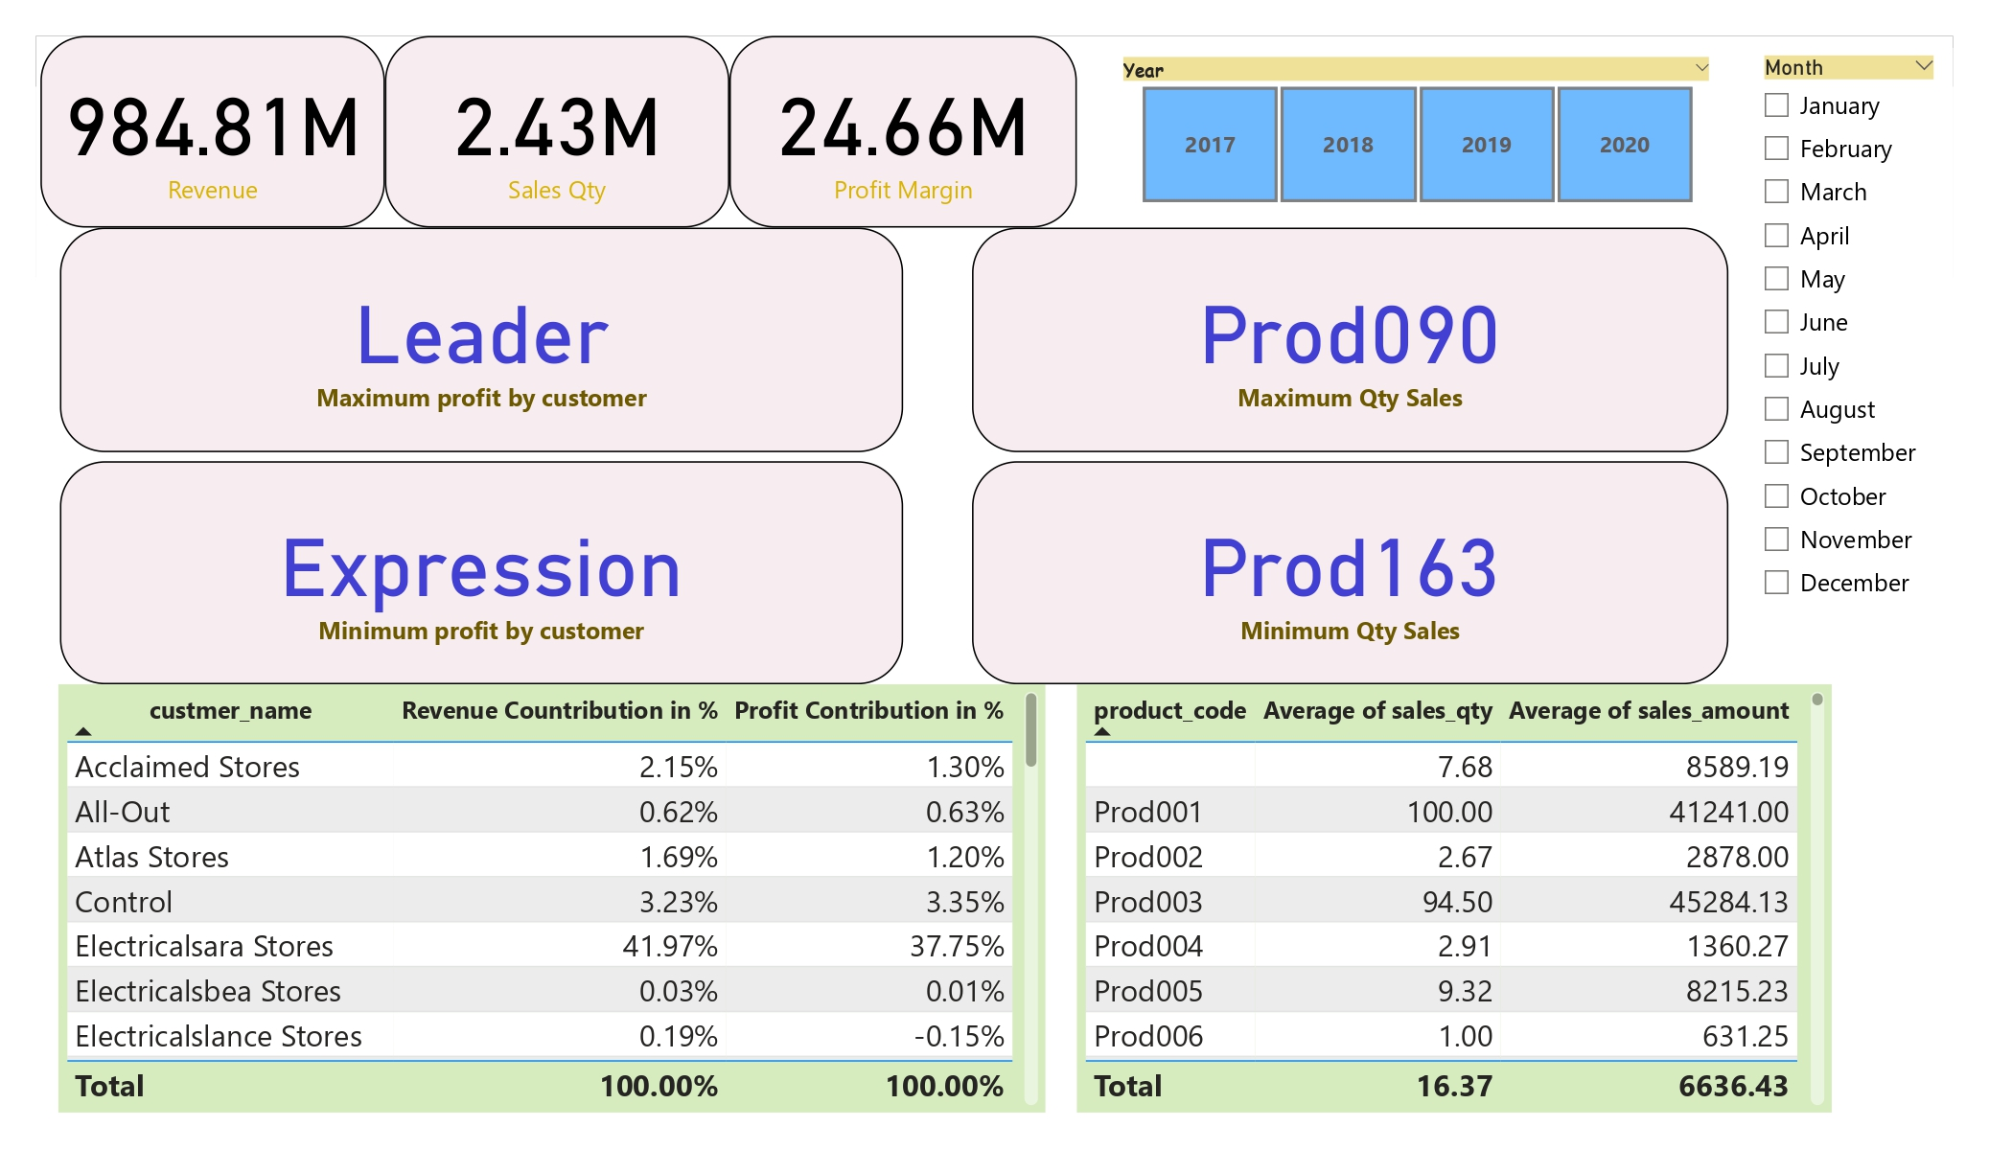
Sales Dashboard

Slide 5
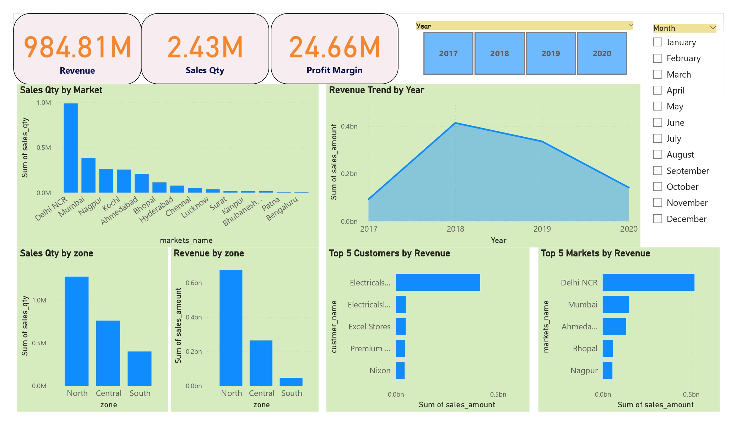
Sales Dashboard

Slide 6

Suggestions
Reasons of declining the Sales :
Demand of the product is low, Prices are high
Nothing new to offer the customers
Quality of product is low
Now invested in marketing
Ignoring your competitors
Not working on ideas and innovations
Change of taste and preferences and ,etc.

Slide 7

What did I learn from this Project ?
Data Importing
Data modelling
Hard Data Cleaning
Attention to details
Dashboarding
Visualization
Data Analyzing

